Slide 1
Where are we going? Daniel Bergman, Ph.D.

Slide 2
2

Slide 3
3

Slide 4
4

Slide 5
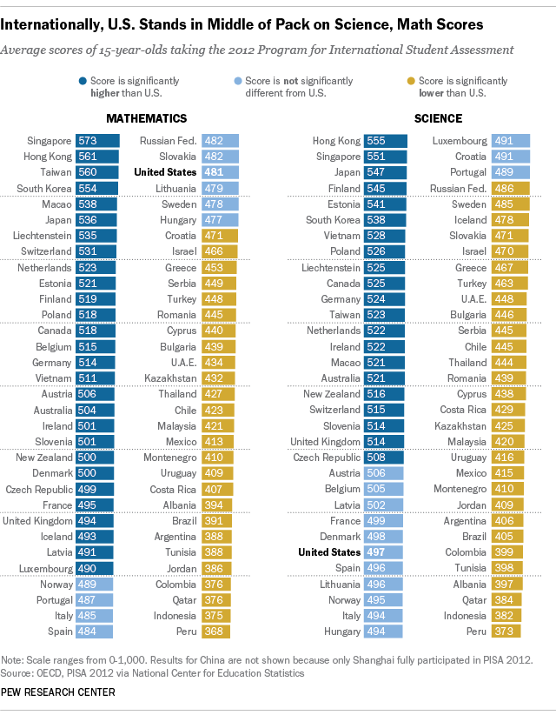
5

Slide 6
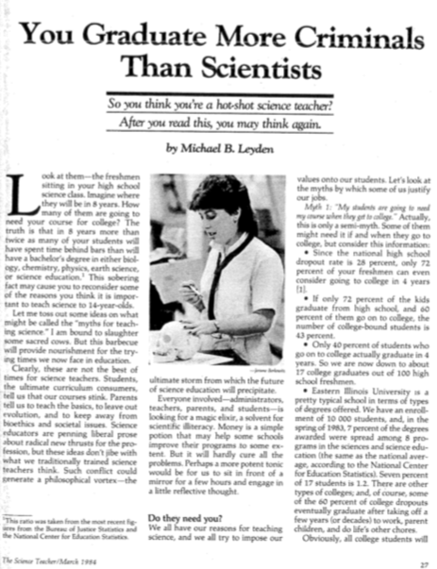
6

Slide 7
National Science Foundation, 2010
7
Bureau of Justice Statistics, 2011

Slide 8
8

Slide 9
9

Slide 10
10

Slide 11
11

Slide 12
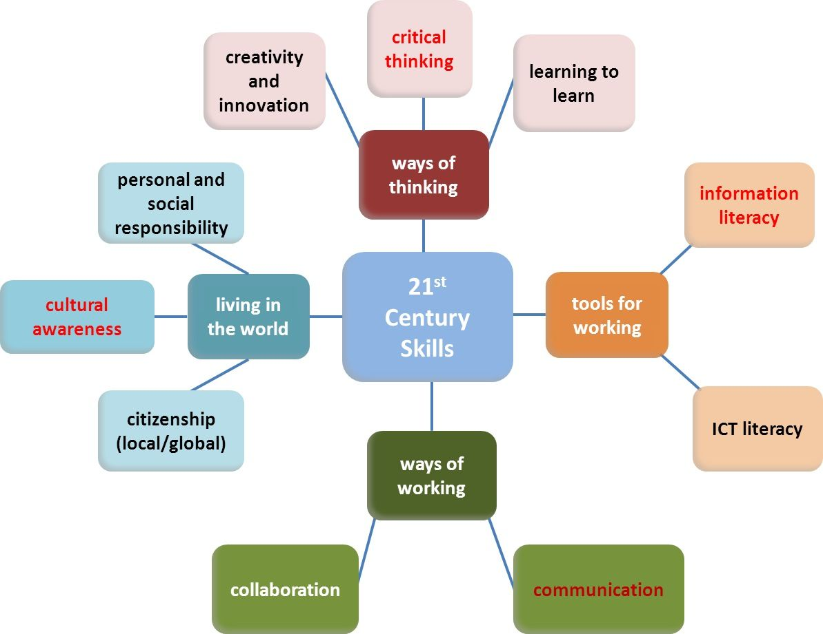
12

Slide 13
13

Slide 14
14

Slide 15
15

Slide 16
16

Slide 17
17

Slide 18
18

Slide 19
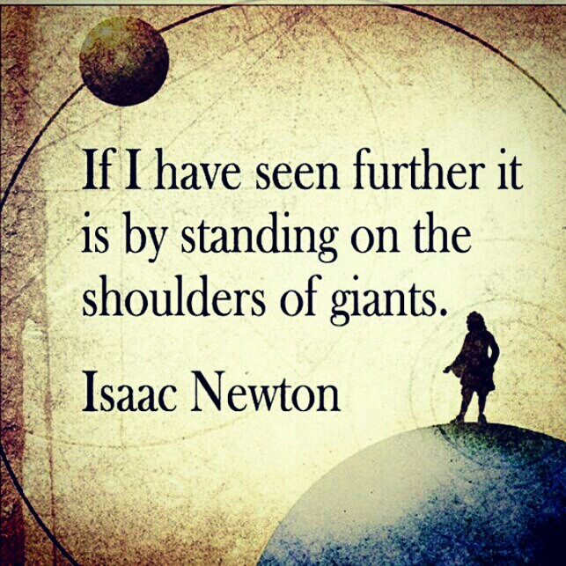
19

Slide 20
Where are we going? Daniel Bergman, Ph.D.
WE
20

